Slide 1

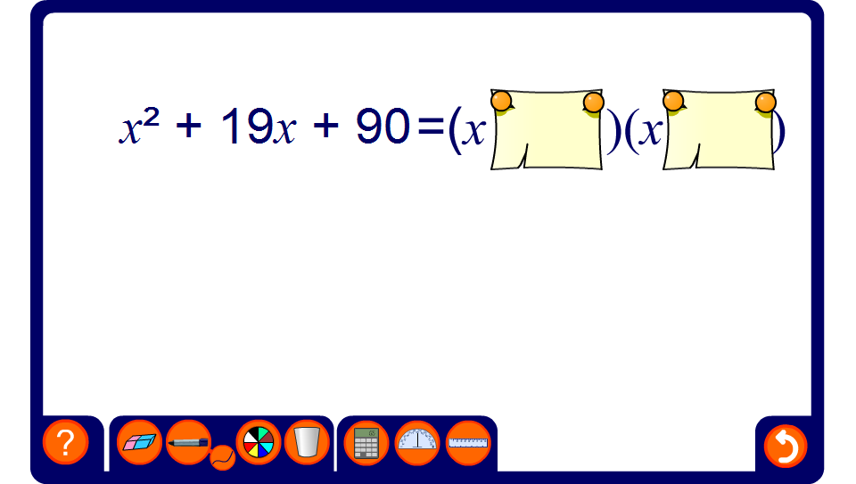


Factorising quadratic expressions 1
Notes:
Factorize the given expression by finding two integers that add together to give the coefficient of x and multiply together to give the constant.
It may be a good idea to practice adding and multiplying negative numbers before attempting this activity. Use slide 31 in N1.2 Calculating with integers to do this if required.
The lower of the two hidden integers will be given first in each case.

Slide 2
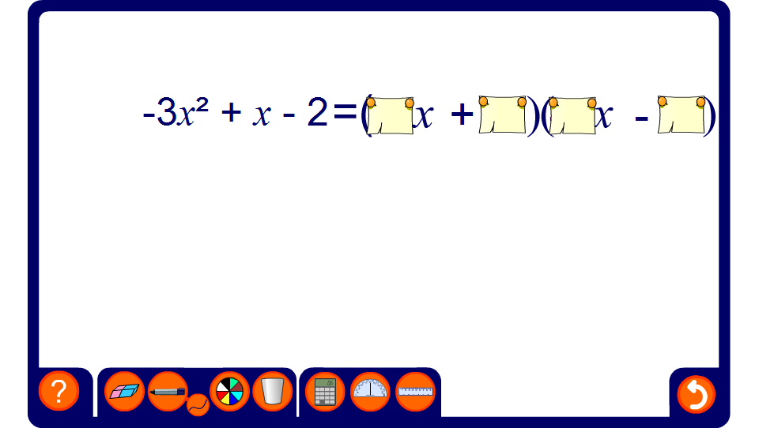
Factorising quadratic expressions 2
Notes:
Factorize each given expression using trial and improvement and the relationships shown on the previous slide.
For each expression in the form ax² + bx + c, start by using the pen tool to write down pairs of integers that multiply together to make a and pairs of integers that multiply together to make c. Use these to complete the factorization.

